Slide 1
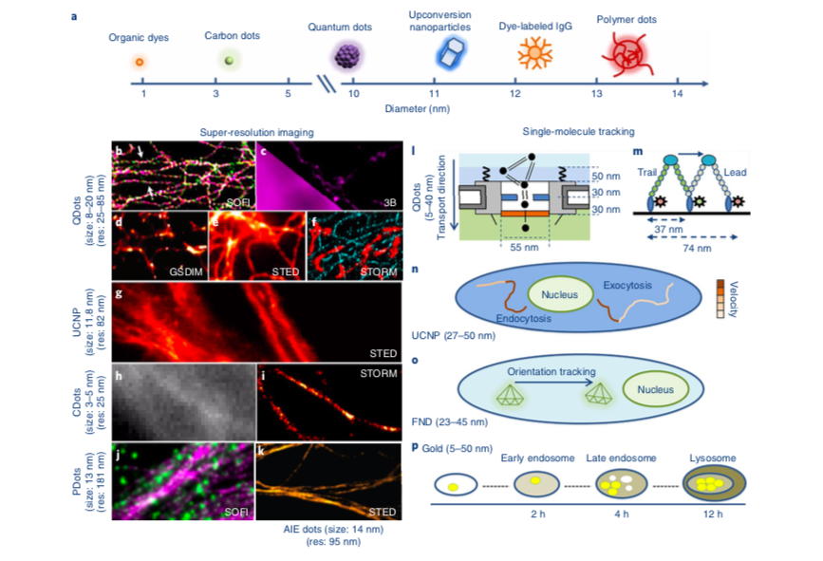
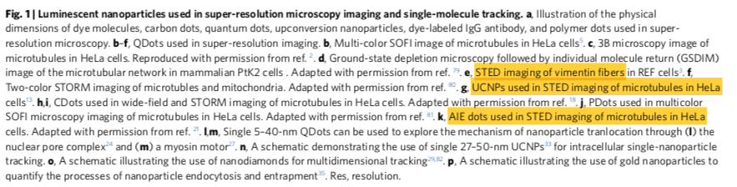
Nanoparticles for super-resolution microscopy and single-molecule tracking
This Perspective focuses on the recent progress and future potential of these small luminescent nanoparticles for use in tracking single molecules and super-resolution imaging of subcellular structures.
Nanoparticles in super-resolution microscopy
The commercially available
ZnS-coated CdSe QDot 705 (from Thermo Fisher),
CdTe QDot 700 nm, and CdTe QDot 720 nm (from PlasmaChem GmbH)
Have proven suitable for stimulated emission depletion (STED) microscopy with spatial resolutions in the range of 50 nm for single QDots, 85 nm for QDot-705-stained microtu- bule networks in HeLa cells2, and 106 nm for vimentin filaments in fibroblasts3.
The high stability of QDots allows for extended time- lapse imaging without any photophysical or photochemical pro- cesses that would diminish their brightness.
A type of 4.5-nm CDot has been developed with burst- like blinking behavior, and its use has been demonstrated for high-density specific labeling of a microtubule network18 (Fig. 1h,i)
PDots are particles that consist predominantly of π-conjugated polymers and have been shown to have superior brightness com- pared with that of conventional QDots19. Very small PDots (10 nm or less) were found to be suitable for fluctuation-based superesolution techniques such as SOFI and 3B20 (Fig. 1j).
To functionalize the PDots, an optically inert polymer, poly(styrene-co-maleic anhy- dride) (PSMA), has been added. The PSMA polymer also generates surface carboxyl groups, which enables specific biomolecular conjugation through biotinylated antibodies20.
Their small size confers improved biocompatibility, and they were shown to be able to label a variety of subcellular organelles such as mitochondria, the nuclear envelope, and microtubules20.
Dayong Jin et al. Nanoparticles for super-resolution microscopy and single-molecule tracking, Nature Methods , VOL 15 | JUNE 2018 | 415–423

